Slide 1

Branch - CSE Python Programming
Lecture – 20 Tuples – Part 1
By
Dr. Smita Tiwari
Assistant Professor
Department of Computer Science and Engineering
School of Engineering & Technology

Slide 2
Python Tuple
A tuple in Python is similar to a list.
The difference between the two is that we cannot change the elements of a tuple once it is assigned whereas we can change the elements of a list.

Slide 3
Creating a Tuple
A tuple is created by placing all the items (elements) inside parenthesis ( ), separated by commas.
The parenthesis are optional, however, it is a good practice to use them.
A tuple can have any no. of items and they may be of different types (integer, float, list, string, etc.).

Slide 4
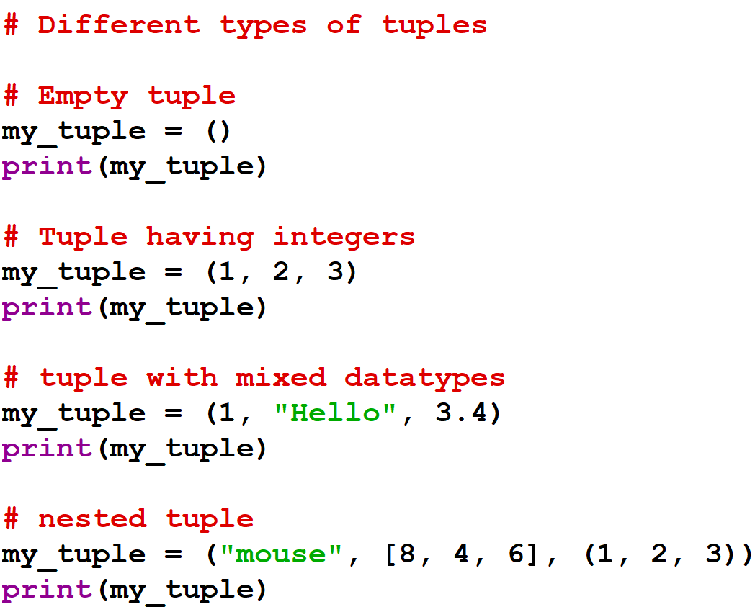
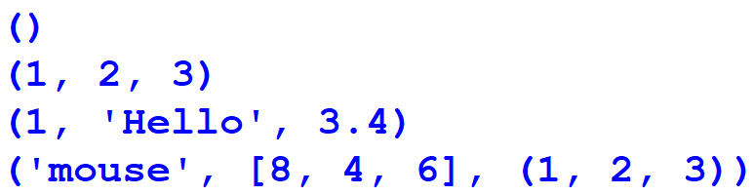
Creating a Tuple
Output:

Slide 5
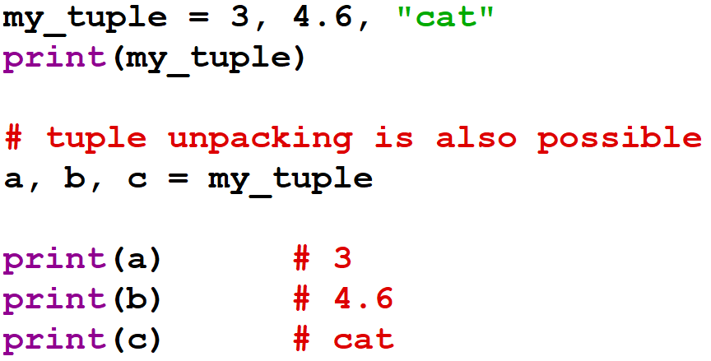
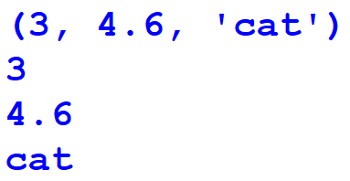
Creating a Tuple
A tuple can also be created without using parenthesis. This is known as tuple packing.
Output:

Slide 6
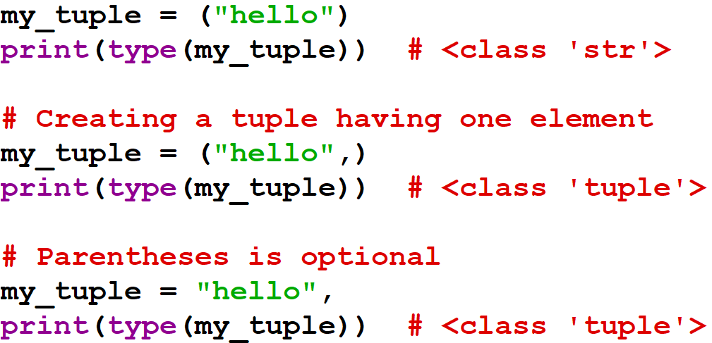
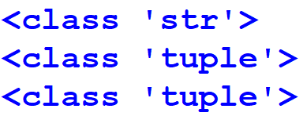
Creating a Tuple
Creating a tuple with one element is a bit tricky.
Having one element within parenthesis is not enough.
A trailing comma is needed
Output:

Slide 7
Access Tuple Elements
Indexing
Negative Indexing
Slicing

Slide 8
Indexing
We can use the index operator [ ] to access an item in a tuple, where the index starts from 0.
So, a tuple having 6 elements will have indices from 0 to 5. Trying to access an index outside of the tuple index range will raise an IndexError.
The index must be an integer, so we cannot use float or other types. This will result in TypeError.
Likewise, nested tuples are accessed using nested indexing.

Slide 9
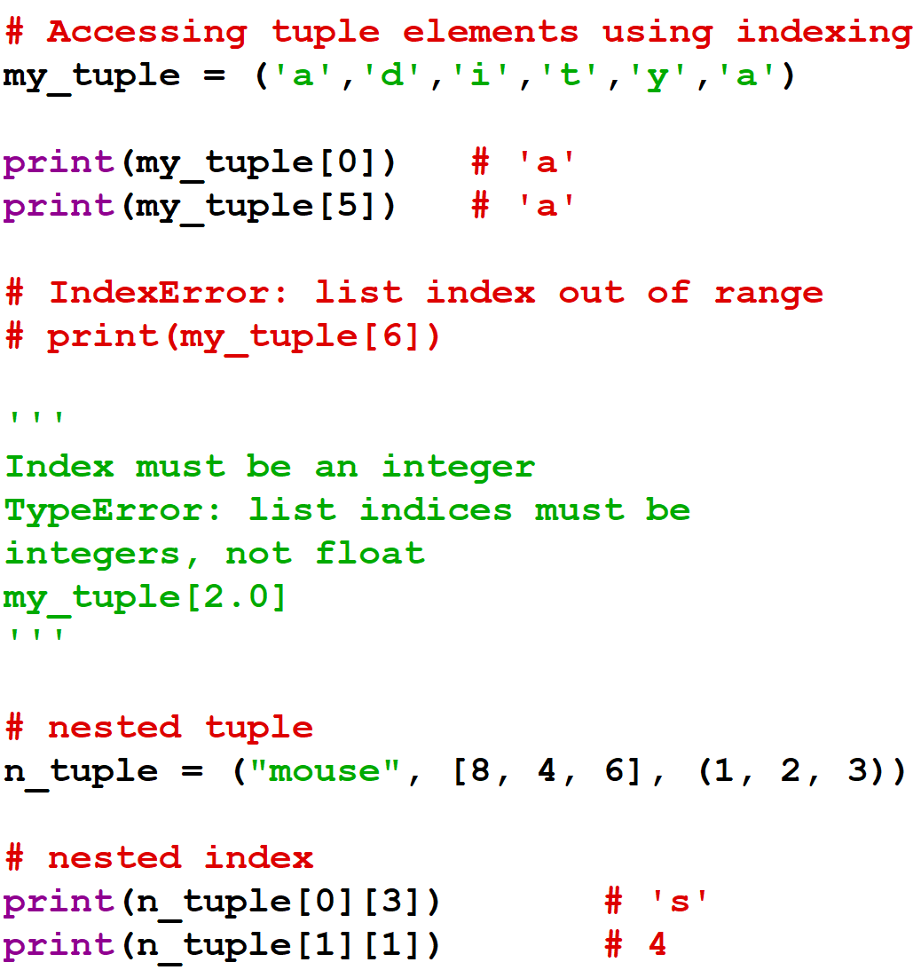

Output:

Slide 10
Negative Indexing
Python allows negative indexing for its sequences.
The index of -1 refers to the last item, -2 to the second last item and so on.

Slide 11
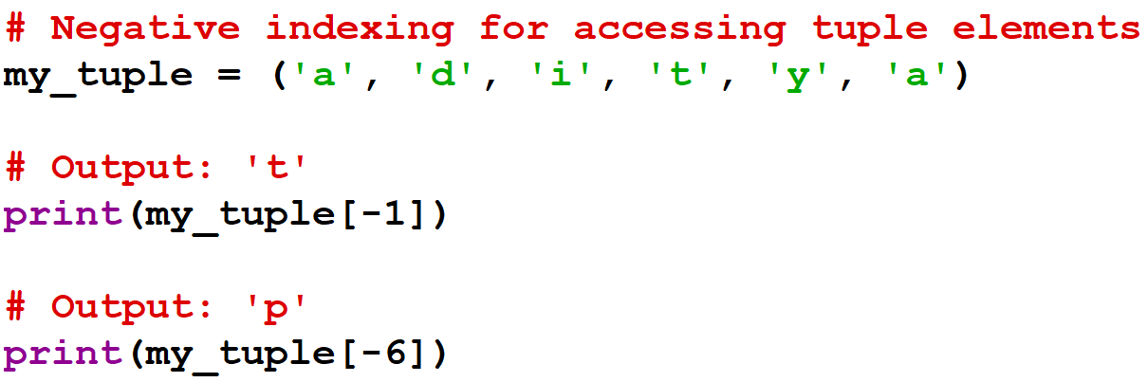

Negative Indexing
Output:

Slide 12
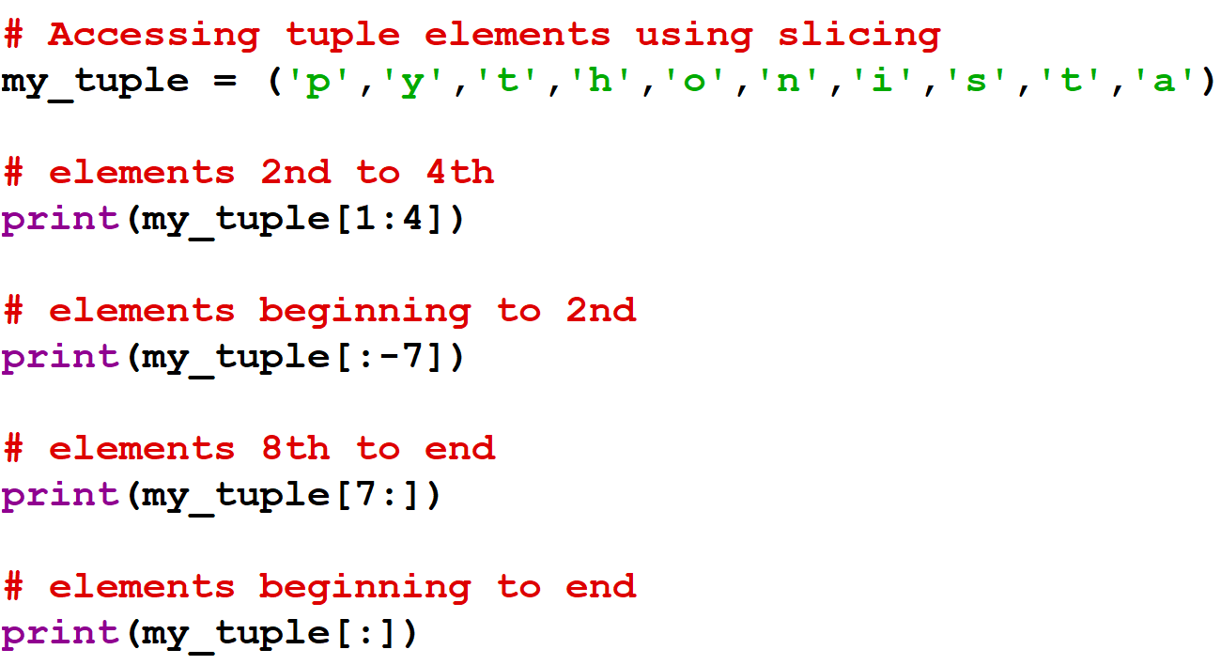
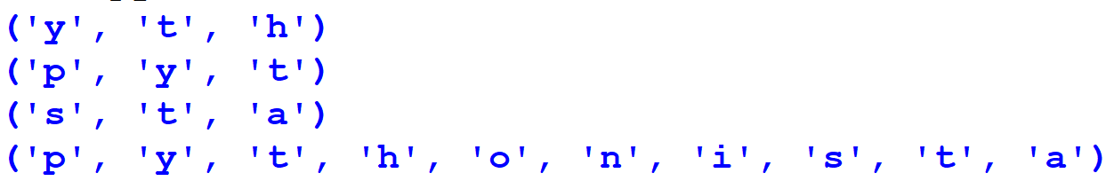
Slicing
We can access a range of items in a tuple by using the slicing operator colon ‘:’.
Output:

Slide 13
Slicing
Slicing can be best visualized by considering the index to be between the elements as shown below.
So, if we want to access a range, we need the index that will slice the portion from the tuple.
P | Y | T | H | O | N | I | S | T | A
0 | 1 | 2 | 3 | 4 | 5 | 6 | 7 | 8 | 9
-10 | -9 | -8 | -7 | -6 | -5 | -4 | -3 | -2 | -1

Slide 14
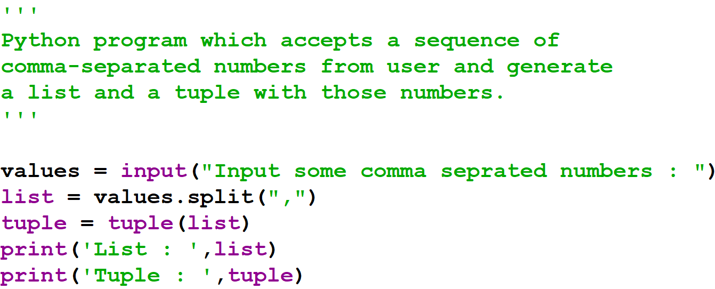
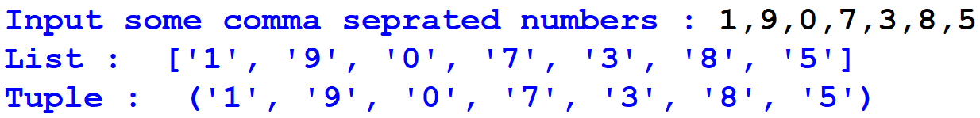
Example #1
Output:

Slide 15
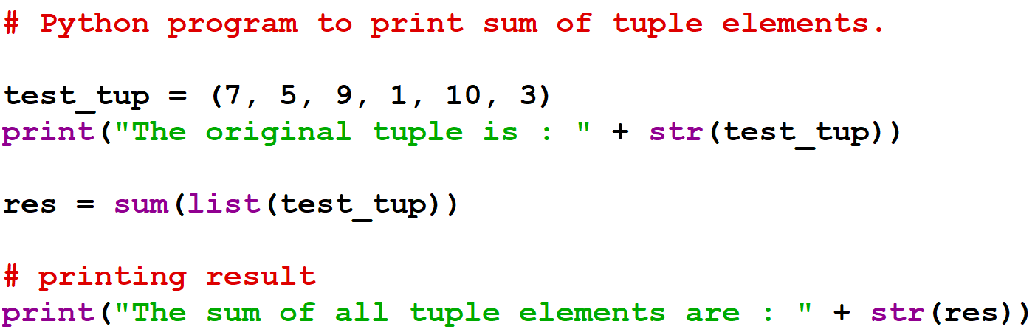
Example #2
Output:

Slide 16
THANK YOU

